Slide 1
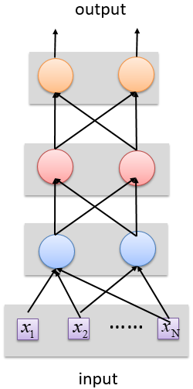
Deep vs Shallow Networks
Deep vs Shallow Networks
Deeper networks perform better than shallow networks
But only up to some limit: after a certain number of layers, the performance of deeper networks plateaus
output
Shallow NN
Deep
NN
……
……
input
Slide credit: Hung-yi Lee – Deep Learning Tutorial

Slide 2
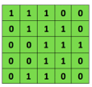

Convolutional Neural Networks (CNNs)
Convolutional Neural Networks
Convolutional neural networks (CNNs) were primarily designed for image data
CNNs use a convolutional operator for extracting data features
Allows parameter sharing
Efficient to train
Have less parameters than NNs with fully-connected layers
CNNs are robust to spatial translations of objects in images
A convolutional filter slides (i.e., convolves) across the image
Convolutional
3x3 filter
Input matrix
Picture from: http://deeplearning.stanford.edu/wiki/index.php/Feature_extraction_using_convolution

Slide 3
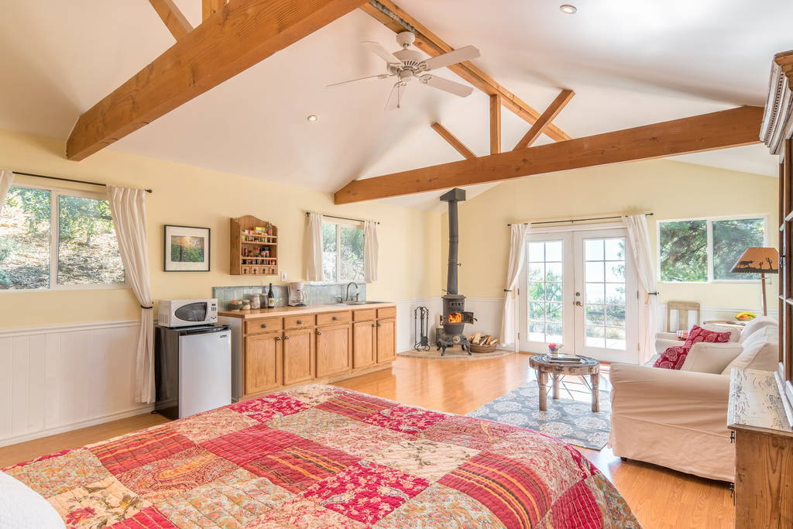
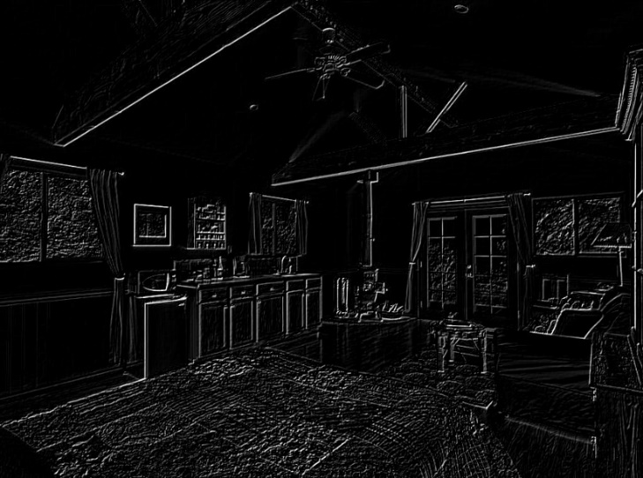
Convolutional Neural Networks (CNNs)
Convolutional Neural Networks
When the convolutional filters are scanned over the image, they capture useful features
E.g., edge detection by convolutions
0 1 0
1 -4 1
0 1 0
Filter
Input Image
Convoluted Image
Slide credit: Param Vir Singh – Deep Learning

Slide 4
Convolutional Neural Networks (CNNs)
Convolutional Neural Networks
In CNNs, hidden units in a layer are only connected to a small region of the layer before it (called local receptive field)
The depth of each feature map corresponds to the number of convolutional filters used at each layer
w1 | w2
w3 | w4
w5 | w6
w7 | w8
Filter 1
Filter 2
Input Image
Layer 1 Feature Map
Layer 2 Feature Map
Slide credit: Param Vir Singh – Deep Learning

Slide 5
Convolutional Neural Networks (CNNs)
Convolutional Neural Networks
Max pooling: reports the maximum output within a rectangular neighborhood
Average pooling: reports the average output of a rectangular neighborhood
Pooling layers reduce the spatial size of the feature maps
Reduce the number of parameters, prevent overfitting
MaxPool with a 2×2 filter with stride of 2
1 | 3 | 5 | 3
4 | 2 | 3 | 1
3 | 1 | 1 | 3
0 | 1 | 0 | 4
4 | 5
3 | 4
Output Matrix
Input Matrix
Slide credit: Param Vir Singh – Deep Learning

Slide 6

Convolutional Neural Networks (CNNs)
Convolutional Neural Networks
Feature extraction architecture
After 2 convolutional layers, a max-pooling layer reduces the size of the feature maps (typically by 2)
A fully convolutional and a softmax layers are added last to perform classification
Living Room
Bedroom
64
64
128
128
256
256
256
512
512
512
512
512
512
Kitchen
Bathroom
Conv layer
Max Pool
Outdoor
Fully Connected Layer
Slide credit: Param Vir Singh – Deep Learning

Slide 7
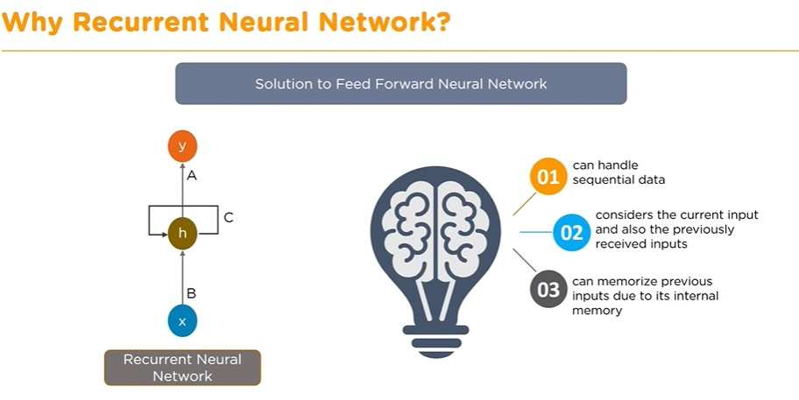

Slide 8
Recurrent Neural Networks (RNNs)
Recurrent Neural Networks
Recurrent NNs are used for modeling sequential data and data with varying length of inputs and outputs
Videos, text, speech, DNA sequences, human skeletal data
RNNs introduce recurrent connections between the neurons
This allows processing sequential data one element at a time by selectively passing information across a sequence
Memory of the previous inputs is stored in the model’s internal state and affect the model predictions
Can capture correlations in sequential data
RNNs use backpropagation-through-time for training
RNNs are more sensitive to the vanishing gradient problem than CNNs

Slide 9














Recurrent Neural Networks (RNNs)
Recurrent Neural Networks
RNN use same set of weights $w_{h}$ and $w_{x}$ across all time steps
A sequence of hidden states $\left\{h_{o},{h_{o}h}_{2},h_{3}, …\right\}$is learned, which represents the memory of the network
The hidden state at step t, $h\left(t\right)$, is calculated based on the previous hidden state $h\left(t−1\right)$ and the input at the current step $x\left(t\right)$, i.e.,$h\left(t\right)=f_{h}\left(w_{h}∗h\left(t−1\right)+w_{x}∗x\left(t\right)\right)$
The function $f_{h}\left(∙\right)$ is a nonlinear activation function, e.g., ReLU or tanh
RNN shown rolled over time
HIDDEN STATES SEQUENCE: ${h_{o},h}_{1},h_{2},h_{3}, ….$
OUTPUT
$$w_{h}$$
$$w_{h}$$
$$w_{h}$$
$$w_{y}$$
h0
$f_{h}$(·)
h1
$f_{h}$(·)
h2
$f_{h}$(·)
h3
$f_{y}$(·)
$$w_{x}$$
$$w_{x}$$
$$w_{x}$$
x1
x2
x3
INPUT SEQUENCE: $x_{1},x_{2},x_{3}, ….$
Slide credit: Param Vir Singh – Deep Learning

Slide 10
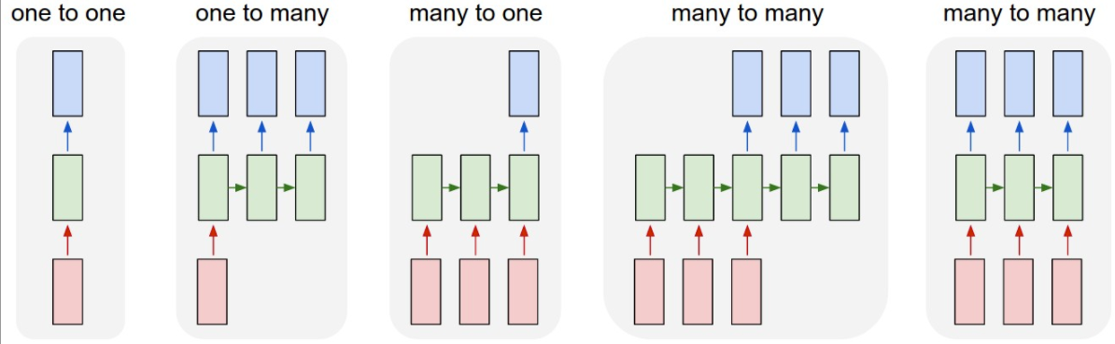

Recurrent Neural Networks (RNNs)
Recurrent Neural Networks
RNNs can have one of many inputs and one of many outputs
RNN
Application
Input
Output
Image Captioning
A person riding a motorbike on dirt road
Sentiment Analysis
Awesome movie. Highly recommended.
Positive
Machine Translation
Happy Diwali
शुभ दीपावली
Slide credit: Param Vir SIngh– Deep Learning

Slide 11
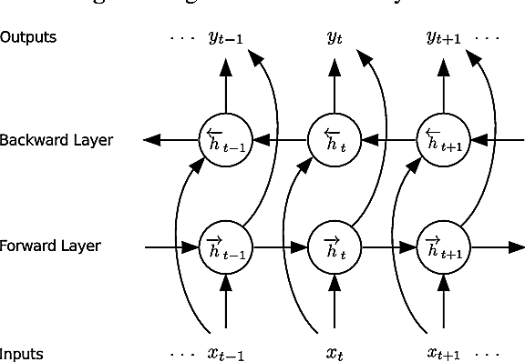



Bidirectional RNNs
Recurrent Neural Networks
Bidirectional RNNs incorporate both forward and backward passes through sequential data
The output may not only depend on the previous elements in the sequence, but also on future elements in the sequence
It resembles two RNNs stacked on top of each other
$${\overset{⃑}{h}}_{t}= σ({\overset{⃑}{W}}^{(hh)}{\overset{⃑}{h}}_{t−1}+{\overset{⃑}{W}}^{(hx)}x_{t})$$
$${\overset{⃖}{h}}_{t}= σ({\overset{⃖}{W}}^{(hh)}{\overset{⃖}{h}}_{t+1}+{\overset{⃖}{W}}^{(hx)}x_{t})$$
$$y_{t}=f\left( \left[{\overset{⃑}{h}}_{t}{;\overset{⃖}{h}}_{t}\right] \right)$$
Outputs both past and future elements
Slide credit: Param Vir Singh – Deep Learning

Slide 12
LSTM Networks
Recurrent Neural Networks
Long Short-Term Memory (LSTM) networks are a variant of RNNs
LSTM mitigates the vanishing/exploding gradient problem
Solution: a Memory Cell, updated at each step in the sequence
Three gates control the flow of information to and from the Memory Cell
Input Gate: protects the current step from irrelevant inputs
Output Gate: prevents current step from passing irrelevant information to later steps
Forget Gate: limits information passed from one cell to the next
Most modern RNN models use either LSTM units or other more advanced types of recurrent units (e.g., GRU units)

Slide 13
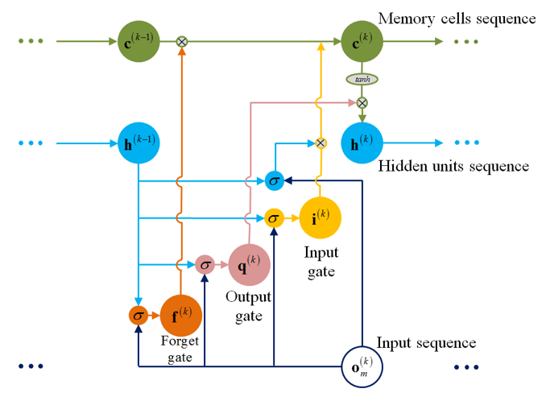
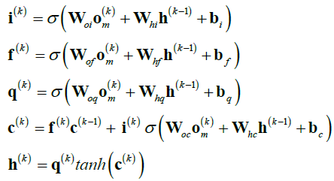
LSTM Networks
Recurrent Neural Networks
LSTM cell
Input gate, output gate, forget gate, memory cell
LSTM can learn long-term correlations within data sequences

Slide 14
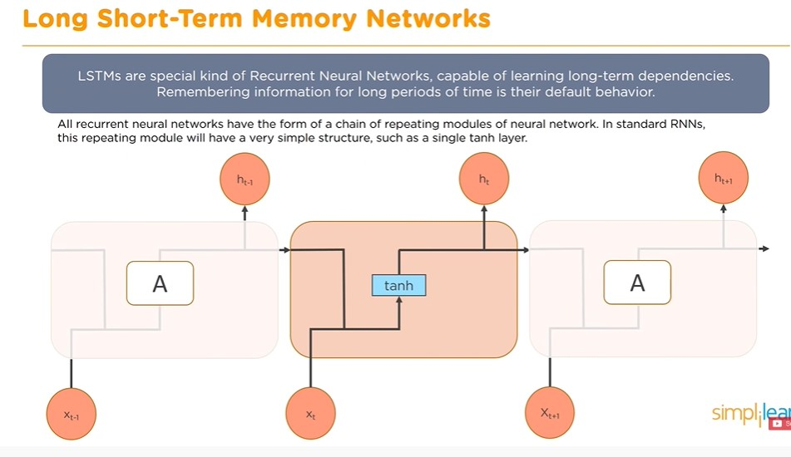

Slide 15
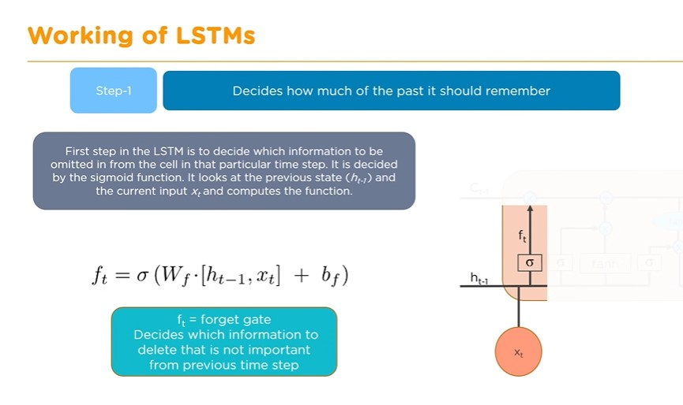

Slide 16
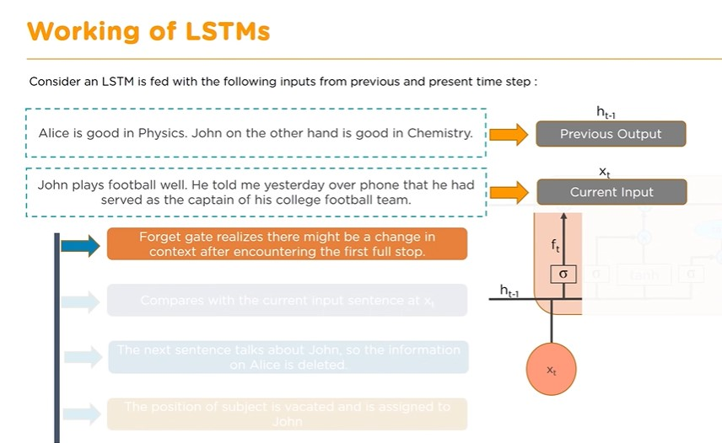

Slide 17
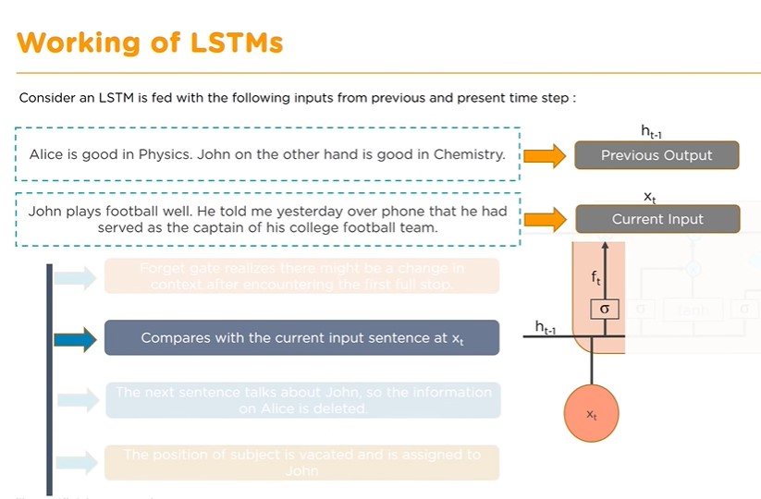

Slide 18
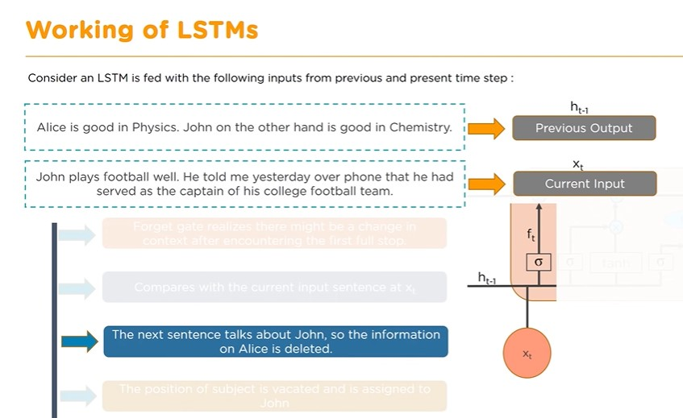

Slide 19
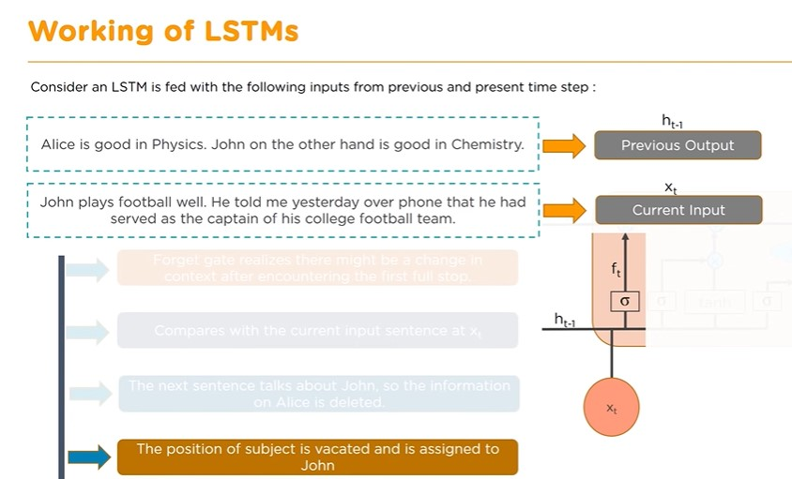

Slide 20
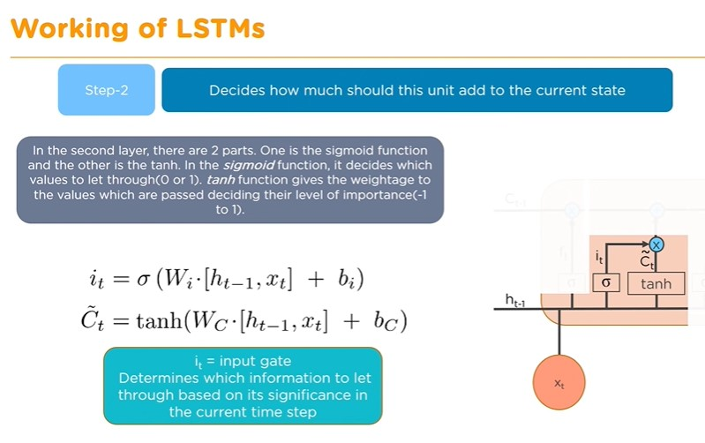

Slide 21
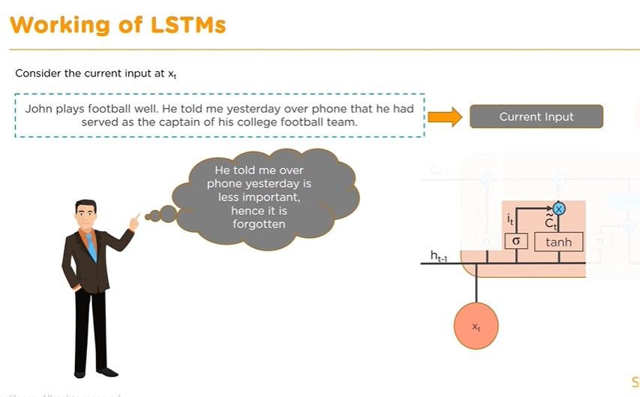

Slide 22
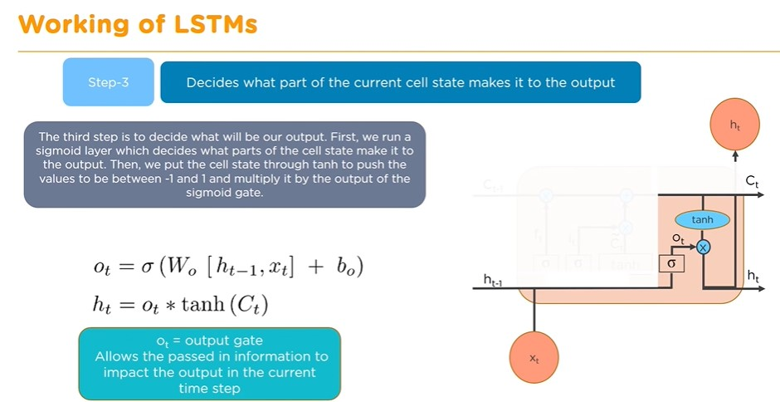

Slide 23
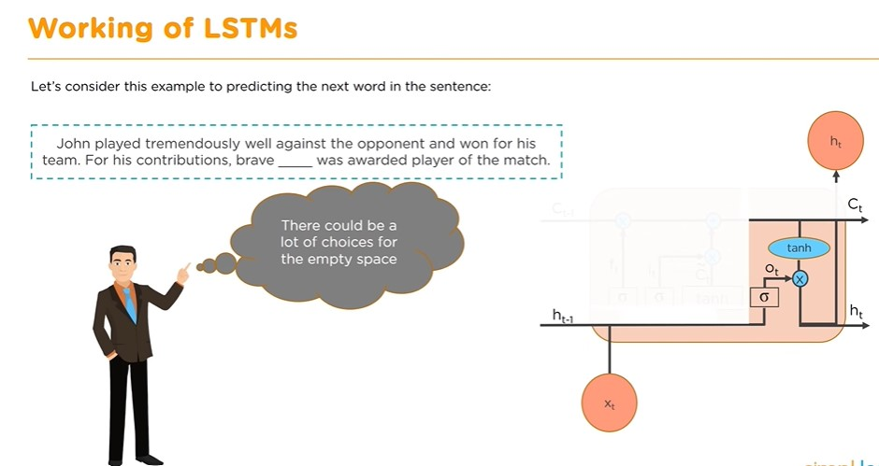

Slide 24
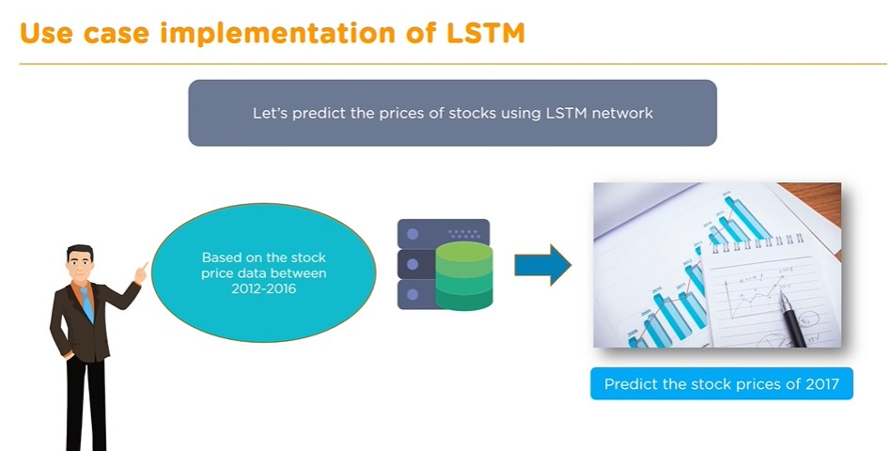

Slide 25
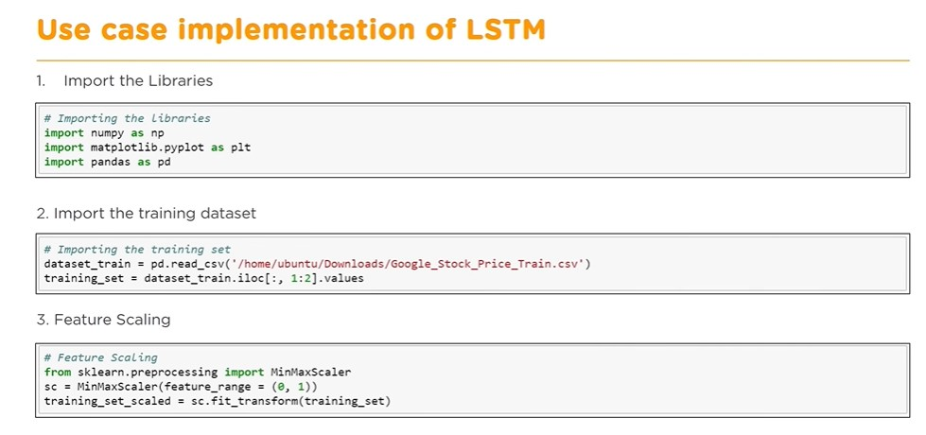

Slide 26
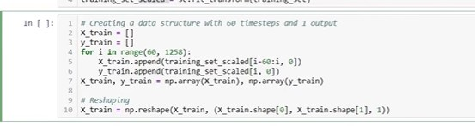

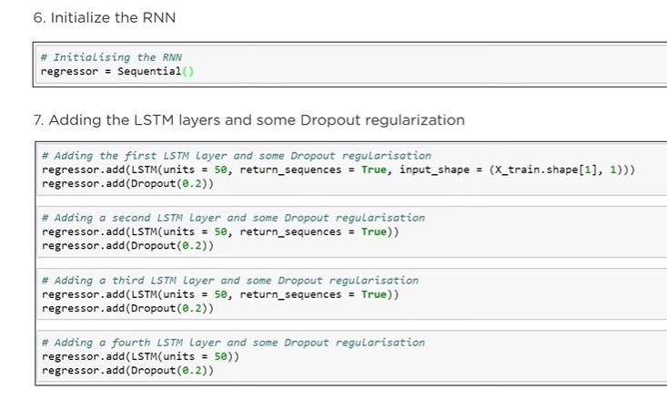

Slide 27
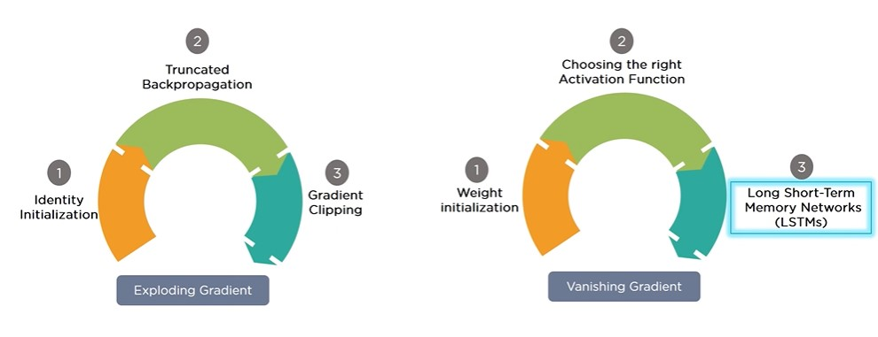
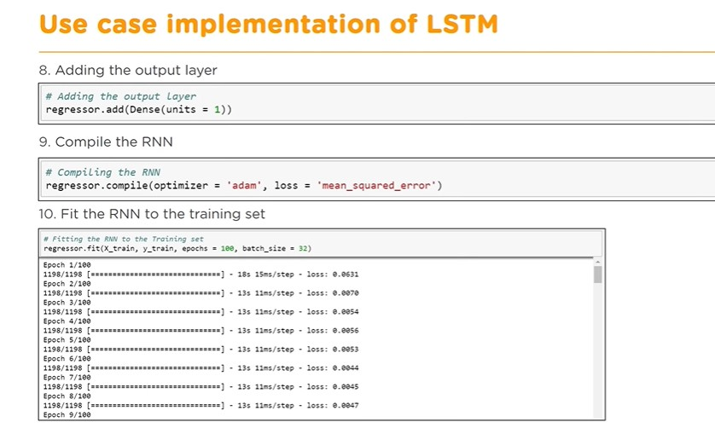

Slide 28
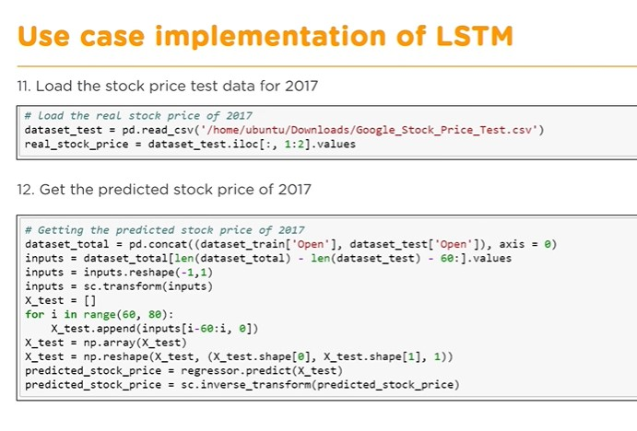

Slide 29
